Slide 1
English Tenses

Slide 2
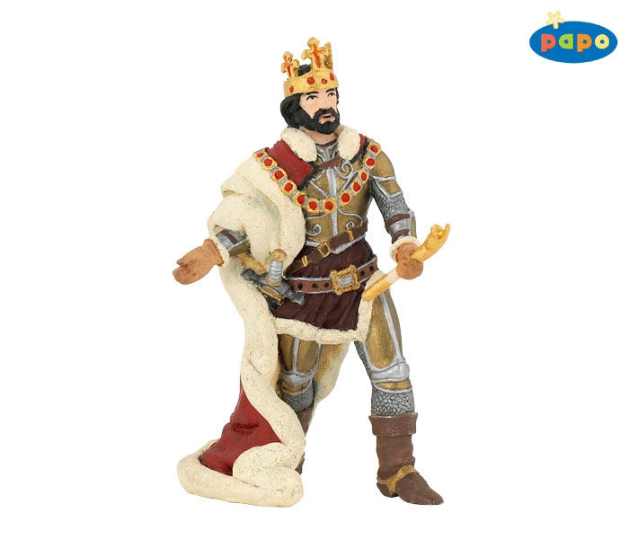
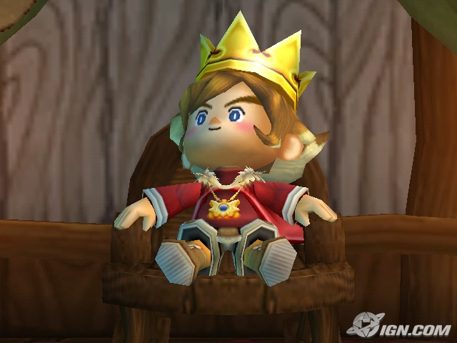
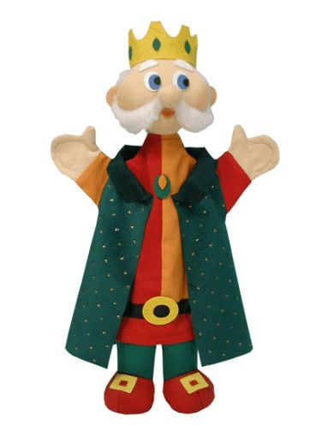
Every day Tomorrow Yesterday

Slide 3
THE KING EVERY DAY

Slide 4
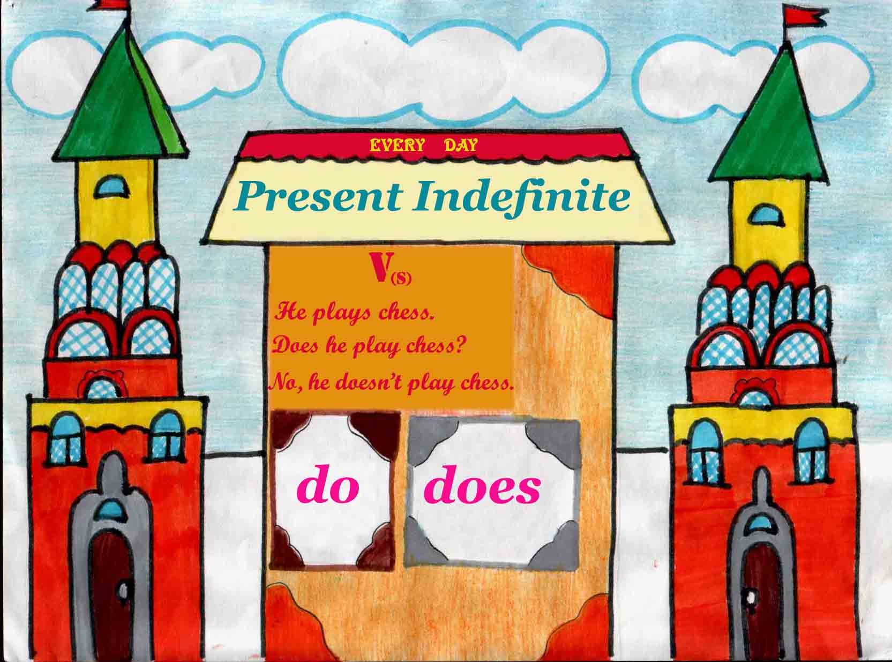

Slide 5
THE KING TOMORROW

Slide 6
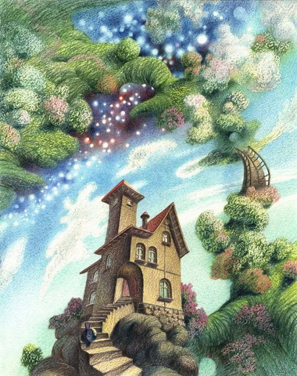
FUTURE INDEFINITE
WILL SHALL V

Slide 7
THE KING YESTERDAY

Slide 8
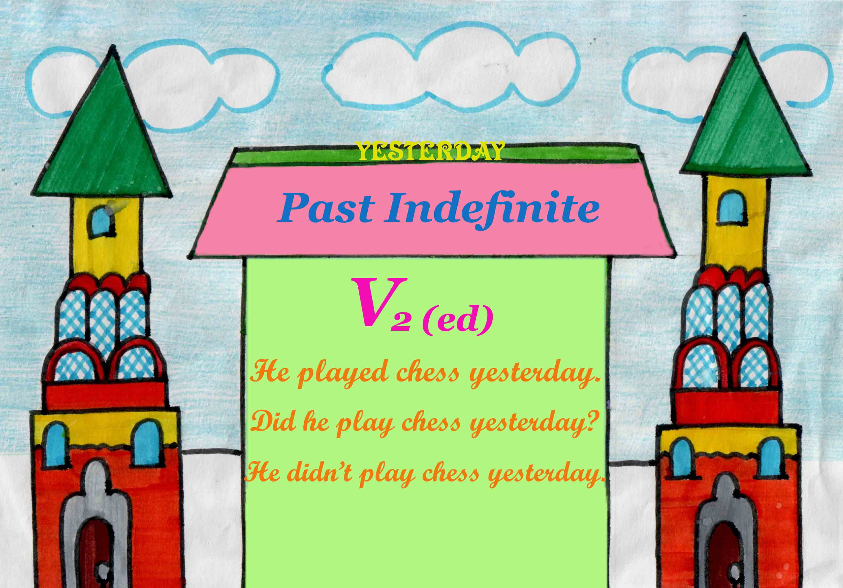

Slide 9
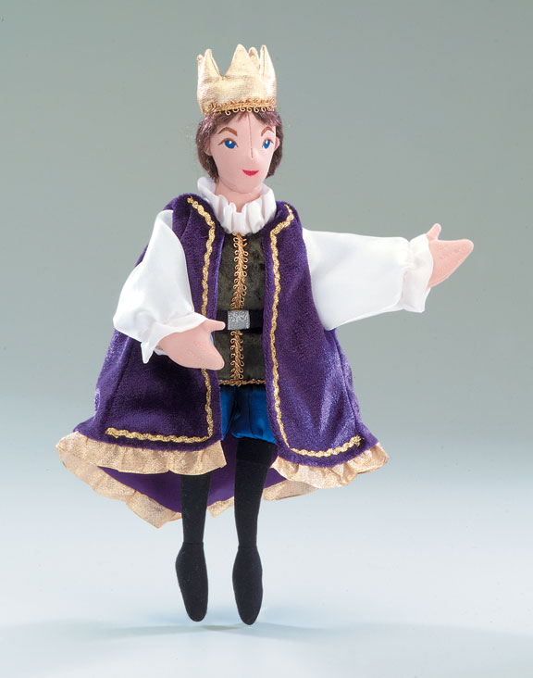
THE KING NOW

Slide 10
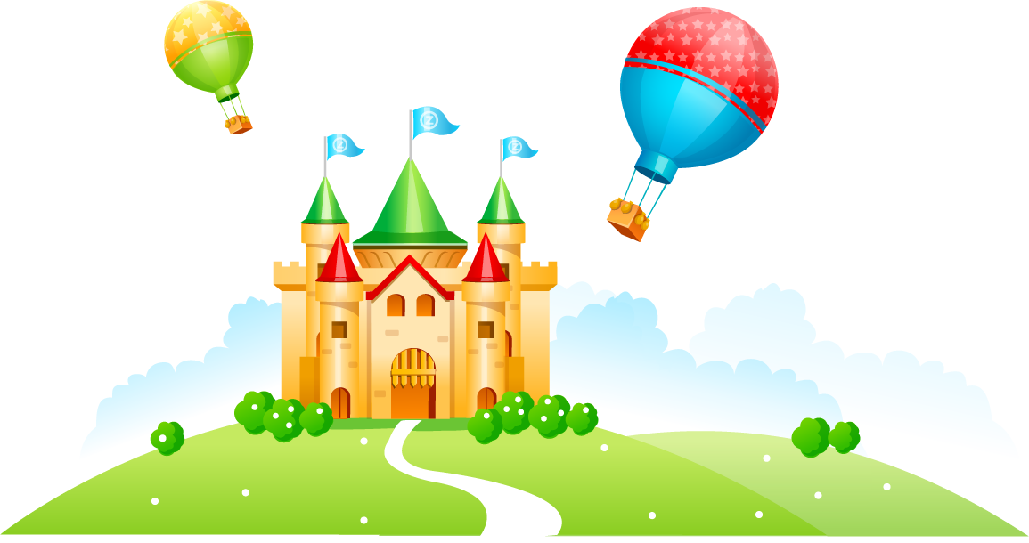
Present Continuous

Slide 11
I am going to the zoo now.
He is going to the zoo now.
She is going to the zoo now.
You are going to the zoo now.
We are going to the zoo now.
They are going to the zoo now.

Slide 12
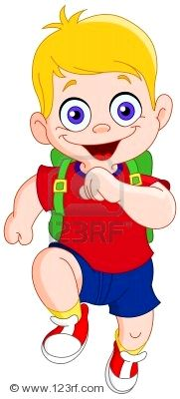
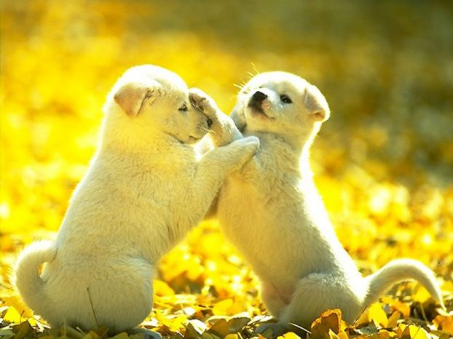
The boy (run) now.
The boy is running now.
Dogs (play) now.
Dogs are playing now.

Slide 13
какую задачу ставили?
удалось ли решить поставленную задачу?
что мы узнали?
что мы научились делать?
каким способом мы пришли к решению задачи?

