Slide 1
professions

Slide 2

a businessman

Slide 3
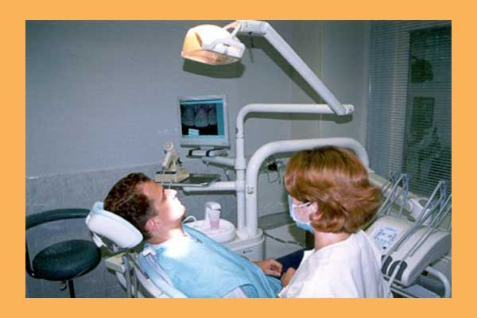
a dentist

Slide 4

a driver

Slide 5
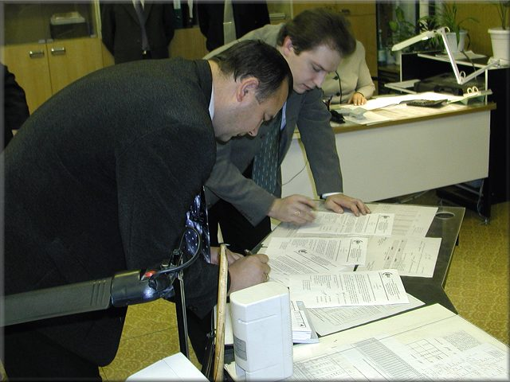
an engineer

Slide 6

a housewife

Slide 7

a lawyer

Slide 8

a librarian

Slide 9

a nurse

Slide 10

parents

Slide 11

a sportsmen

Slide 12

a computer programmer

Slide 13

a office worker

